Slide 1
Version Control with Git

Slide 2
Agenda
What why and how of version control
Centralized vs. Distributed version control
Introduction to Git
Basic Git concepts
Setting up Git
Git commands
Git good practices

Slide 3
What is Version Control ?
A system that records changes to file(s)
Provides control over changes
Every change is tracked
Why the change happened?
References to problem fixed
Who introduced an issue and when
Revert back to a previous state

Slide 4
Why do we need it?
Version tracking
Maintaining multiple versions of software
Coordinating within/between teams
Not to lose anything
Experimentation without interference

Slide 5

Centralized Version Control
A single server that contained all versioned files(Eg- subversion)

Slide 6
Disadvantages of Centralized System
Single point of failure
If hard disk gets corrupted without proper backups everything is lost.

Slide 7
Distributed Version Control
Every developer has a copy
Have full version history on hard drive
Faster except for remote repository operations

Slide 8
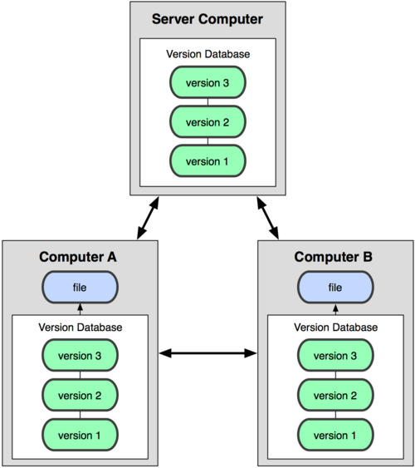
Distributed Version Control

Slide 9
Centralized vs Distributed
http://www.youtube.com/watch?v=_yQlKEq-Ueg

Slide 10
Introduction to Git
Developed and designed by Linus Torvalds
Very high performance
Strong safeguard against accidental changes

Slide 11
Characteristics of Git
Strong support for non linear development
Fully Distributed
Efficient handling of large projects
Simple Design

Slide 12
Basic Git Concepts
Git has following three states for files:
Committed : it means that the data is safely stored in local database.
Modified : it means that the file is changed but not committed to database yet.
Staged : it means that the file is marked to go into next commit snapshot.

Slide 13
Basic Git Concepts
Commit
A snapshot
Represents checked in version of files/directories
Uniquely identified by a 40 char string
Has a reference to the parent commit
Tree based structure when branching

Slide 14
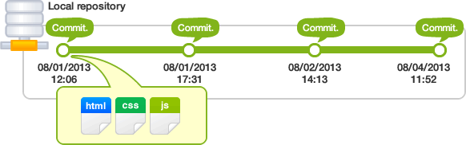
Basic Git Concepts

Slide 15
Basic Git Concepts
Working tree and index
working tree : consists of files that you are currently working on.
Index : is a staging area where new commits are prepared. It acts as an interface between repository and working tree.
Changes made on the working tree will not be committed directly to the repository. They need to be staged on index first.

Slide 16
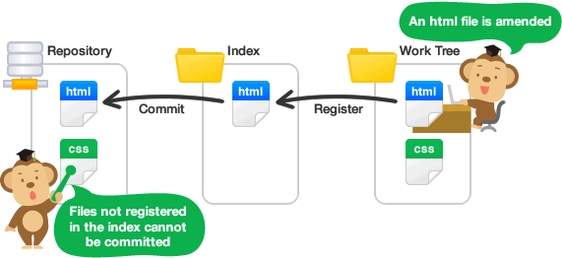
Basic Git Concepts

Slide 17
Basic Git Concepts
Remote Repository and Local Repository
Remote Repository : Repository that resides on a server and is shared among all team members.
Local Repository : Repository that resides on a local machine of an individual.

Slide 18
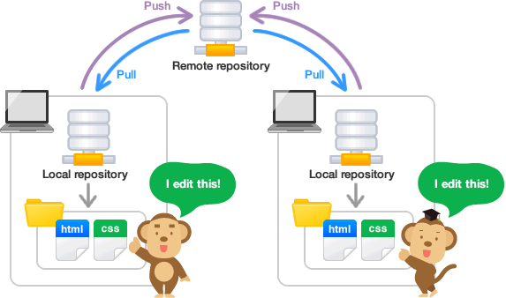
Basic Git Concepts

Slide 19
Basic Git Concepts
Remote Repository -- Remote
Possible to have more than one repository
An alias for each repository
Update from it with fetch and pull commands
Send updates with push

Slide 20
Basic Git Concepts
Branch
An active line of development
Most recent commit on branch is referred as “tip”
A single git repo can track an arbitrary number of branches.
But working tree is associated with one of them and HEAD points to that branch.

Slide 21
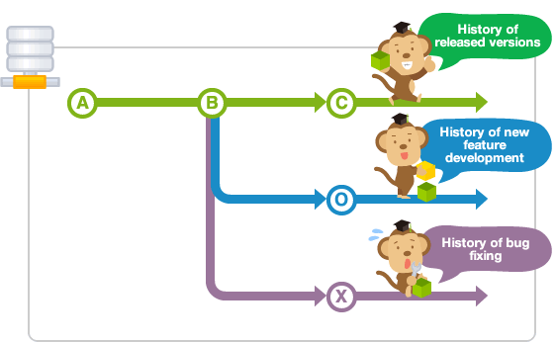
Basic Git Concepts

Slide 22
Basic Git Concepts
Merge Conflict
Same line of a file can be edited by multiple people
Or even in different branches
Git is intelligent in case the changes are at different line numbers in a file

Slide 23
Setting up Git
Sudo apt-get intall git
git needs your SSH public key to allow pushing and pulling
git config –global user.name <name>
git config –global user.email <email>

Slide 24
Git Commands
init : initialize a directory as git repo
add: add file(s) to git
rm : remove file(s) from git
commit : commit staged files
checkout: checkout files/branches
branch: view branches
push : update remote repo with changes of local repo
pull : update local repo with changes of remote repo

Slide 25
Git Commands
stash : manage stash
remote: manage set of tracked repos
merge : merge changes
Resolving merge conflicts
Edit
Add edited files
Commit files

Slide 26
Ignoring files in git
.gitignore : Its not a command but a file which consists of file names which should not be checked in the VCS. Please remember that this file itself will be checked in the VCS.

Slide 27
Git good practices
Atomic commits
Meaningful commit messages
Use of gitignore

Slide 28
Git References
Git Manual page
Git cheat sheet
https://www.codeschool.com/courses/git-real

Slide 29
Questions....

